Slide 1
Screenshots: How to download Pathways of Progress data and calculate distributions

Slide 2
Under “view my data”, scroll down to last option “access raw data”, and click on the icon to “download your data”

Slide 3
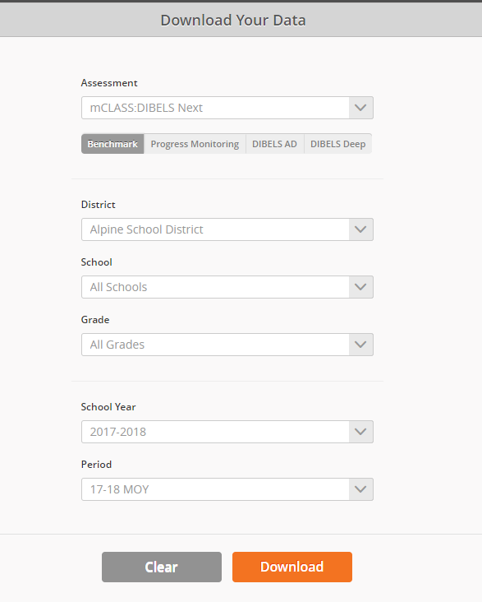
Select the desired dataset from the options on the left. Make sure to request 18-19 MOY data to get a current dataset for Pathways of Progress.
For Grades, select 1-3

Slide 4
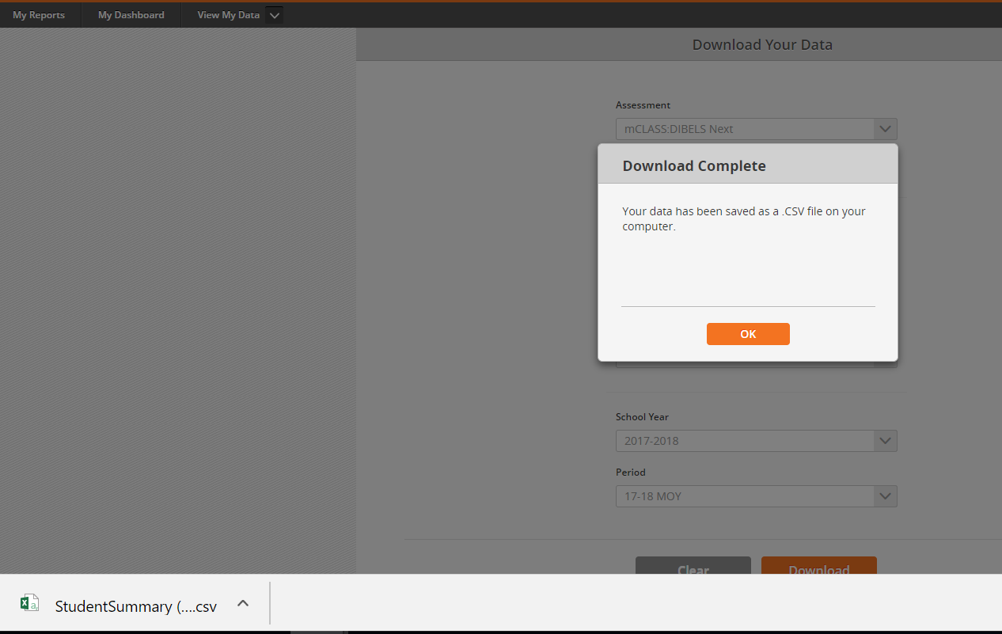
Once download is complete, open resulting file
(.csv format, should open in Excel)

Slide 5
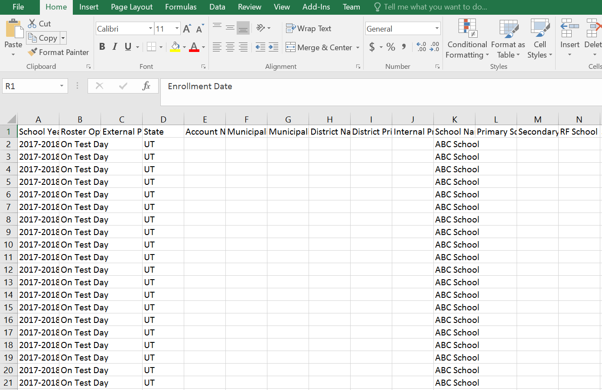
If you wish to spend time scanning through columns, you may find it helpful to wrap the text so that the column field names are legible. To do so, highlight the row/cells, and click “wrap text” from the menu above.

Slide 6
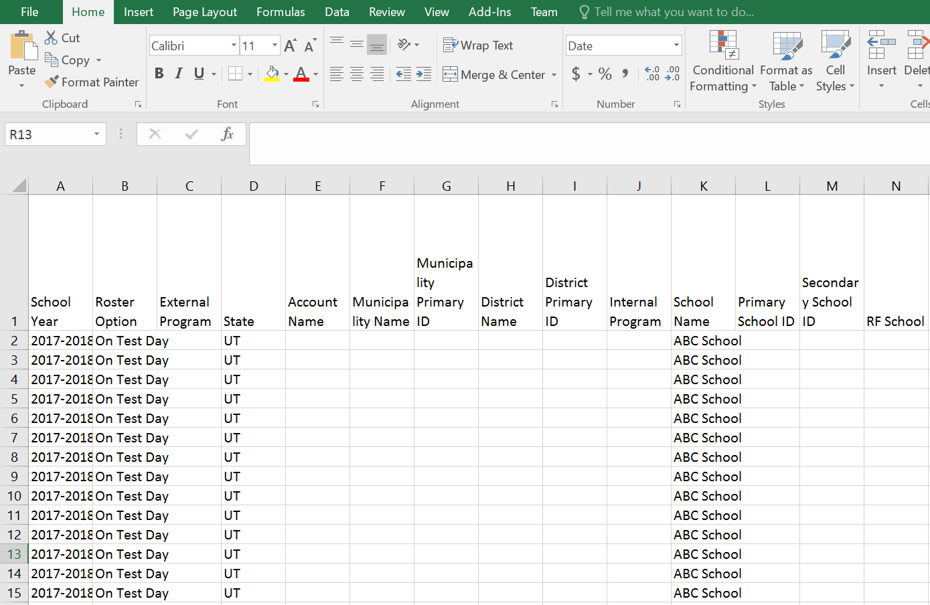
The row height should now have expanded, and the text should have wrapped, making it easier to read the names in the column headers.

Slide 7
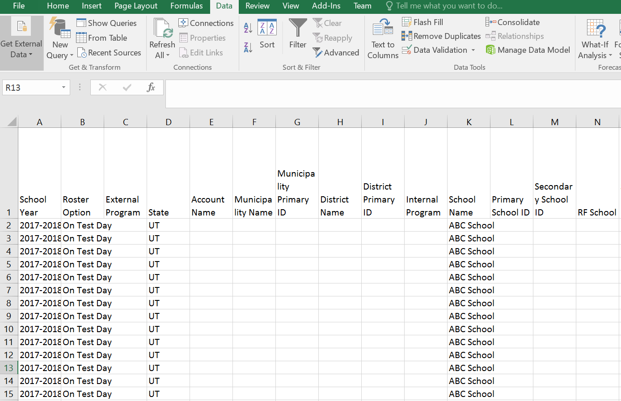
Since this is a “quick-and-dirty” calculation, we will use a simple “filter” function to assemble data for the pathways calculations.

Slide 8
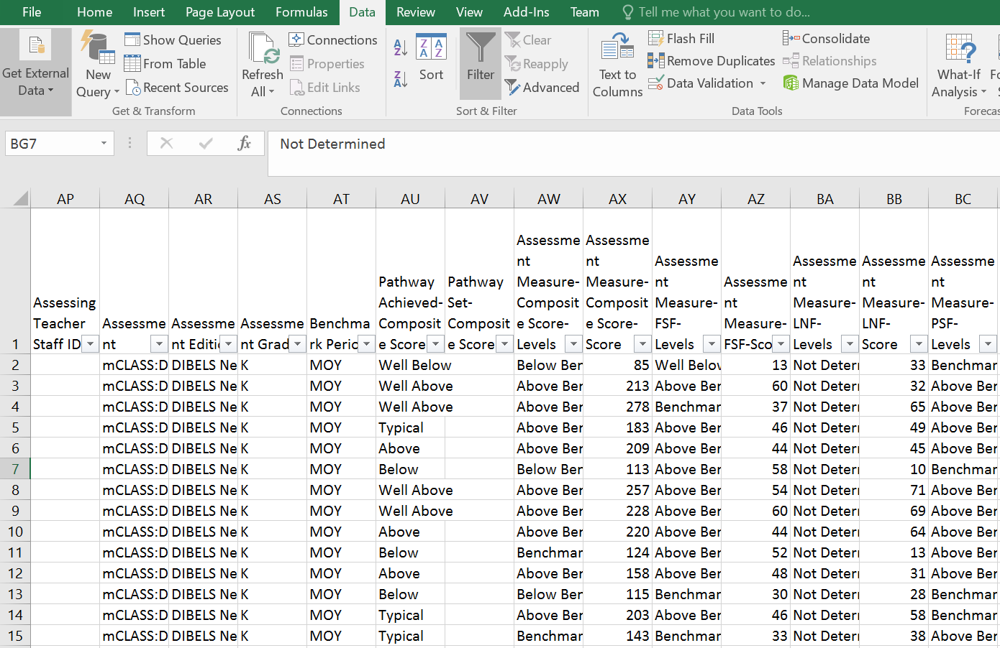
You will use the drop-down filters to narrow the data to the desired range. Scroll to the right to the only columns you will need: Assessment Grade and Pathway Achieved - Composite Score.

Slide 9
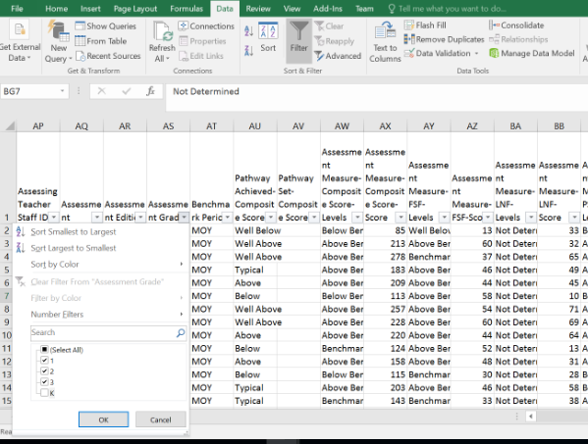
By filtering assessment grade to include only grades 1-3, you can narrow the dataset to the desired grades. You only need to filter the grades if you did not select grades 1-3 in the initial dropdown section of this report.

Slide 10
Calculating % of Students Making Typical or Better Progress (Pathway Achieved) in Grades 1-3 The calculation (see below) is very simple - you simply need to determine what numbers to use for the numerator and denominator
Number of Students Making Typical or Better Progress (i.e., Pathway Achieved is “Typical”, “Above Typical” or “well Above Typical”)
=
% of Students Making Typical or Better Progress
Total Number of Students with a Pathway Achieved

Slide 11
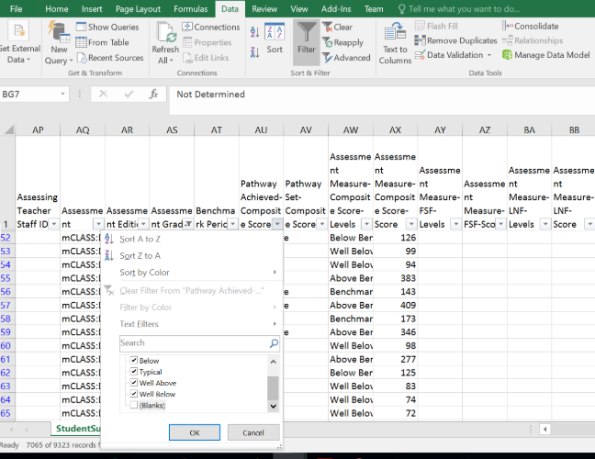
Filter Pathway Achieved to include only students who have achieved a Pathway (i.e., were assessed at both BOY and MOY). To do this, uncheck the box by the word Blanks in column AU.
This is your denominator. You will see the number on the left at bottom of screen.

Slide 12
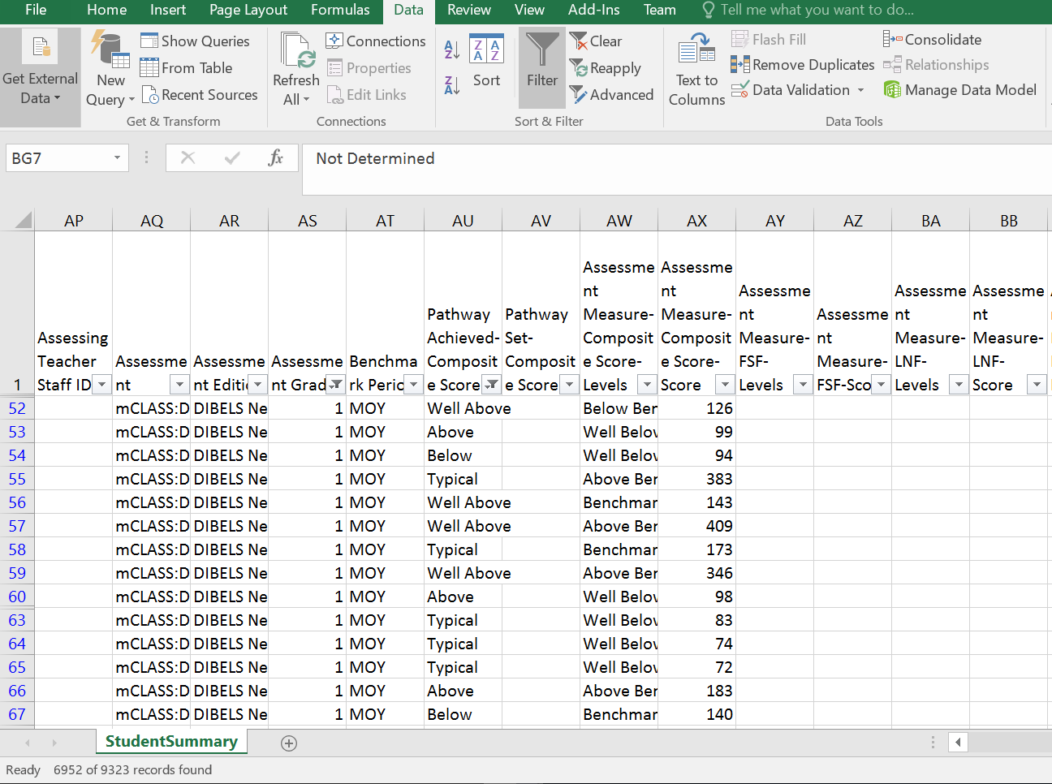
Once the filter has been applied (i.e., after you click “OK”), you will see the number of students at the left at bottom of screen has been adjusted to reflect this narrowed dataset. This is the number to use for the denominator.

Slide 13
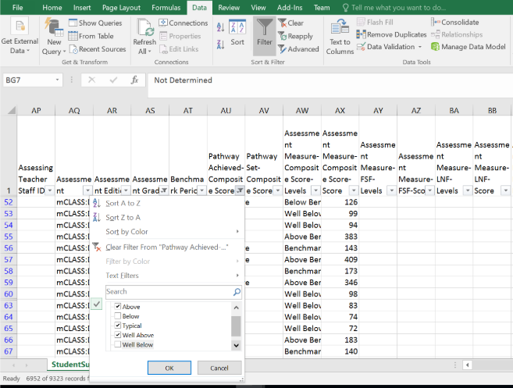
By filtering pathway achieved again to only include students who have achieved a pathway that is typical, above typical, or well above typical progress, you can narrow down to students who have made typical or better progress,. This is your numerator.

Slide 14
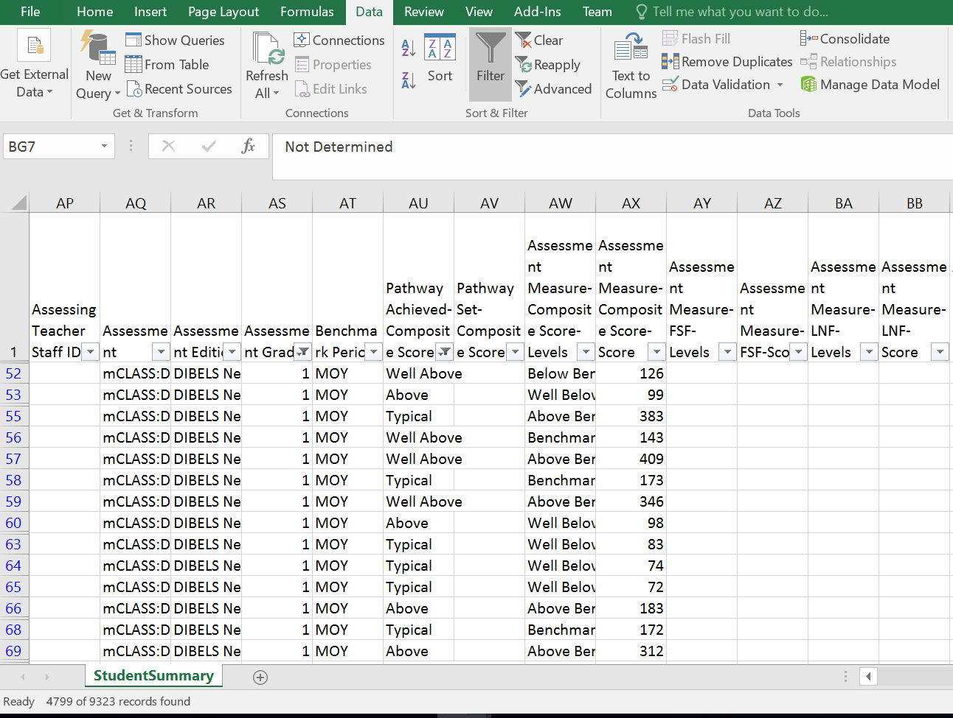
Once the filter has been applied (i.e., after you click “OK”), you will see the number of students at the left at bottom of screen has been adjusted to reflect this narrowed dataset. This is the number to use for the numerator.

Slide 15
Calculating % of Students Making Typical or Better Progress (Pathway Achieved) in Grades 1-3
Number of Students Making Typical or Better Progress (i.e., Pathway Achieved is “Typical”, “Above Typical” or “well Above Typical”)
=
% of Students Making Typical or Better Progress in grades 1-3
Total Number of Students with a Pathway Achieved
4,799
=
69.03%
UGG at MOY
6,952

Slide 16
Calculating % of Students Making Typical or Better Progress (Pathway Achieved) in Grades 1-3
Number of Students Making Typical or Better Progress (i.e., Pathway Achieved is “Typical”, “Above Typical” or “well Above Typical”)
District is on Track to Meet UGG (60%) by End of Year
=
% of Students Making Typical or Better Progress
Total Number of Students with a Pathway Achieved
4,799
=
69.03%
6,952

