Slide 1
Please make a copy before you begin working.
(File → Make a copy → Save to your drive)

Slide 2
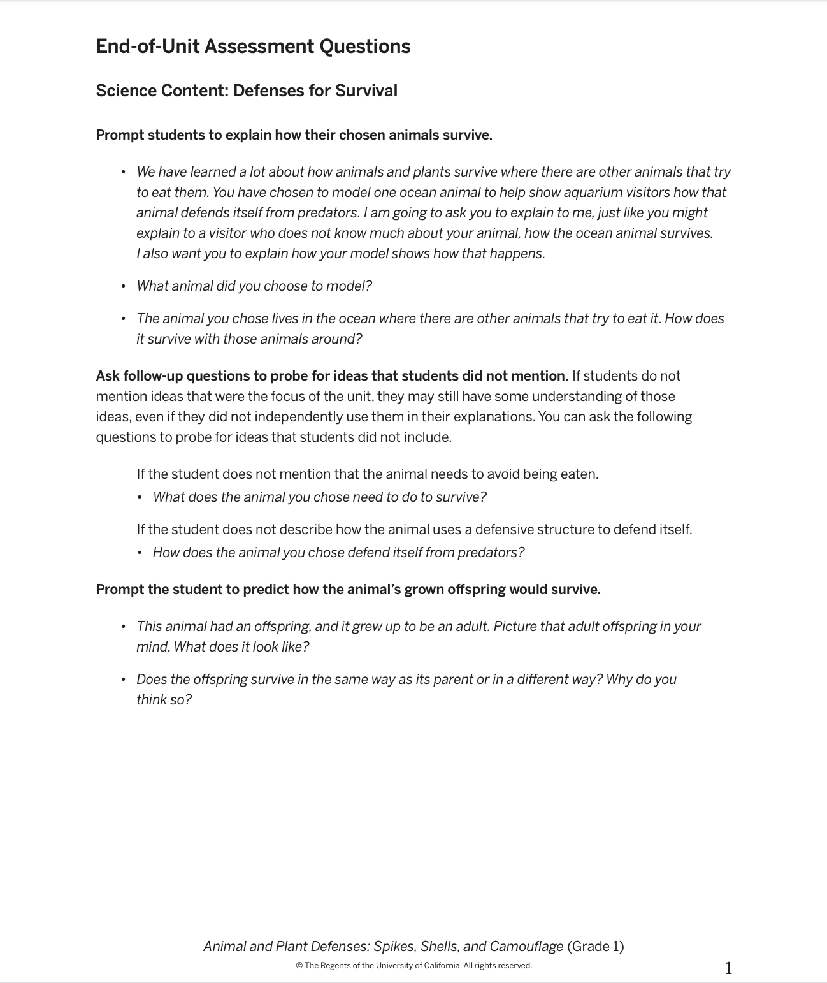
Type your responses here…
1.
2.
3.
4.
5.
6.

Slide 3
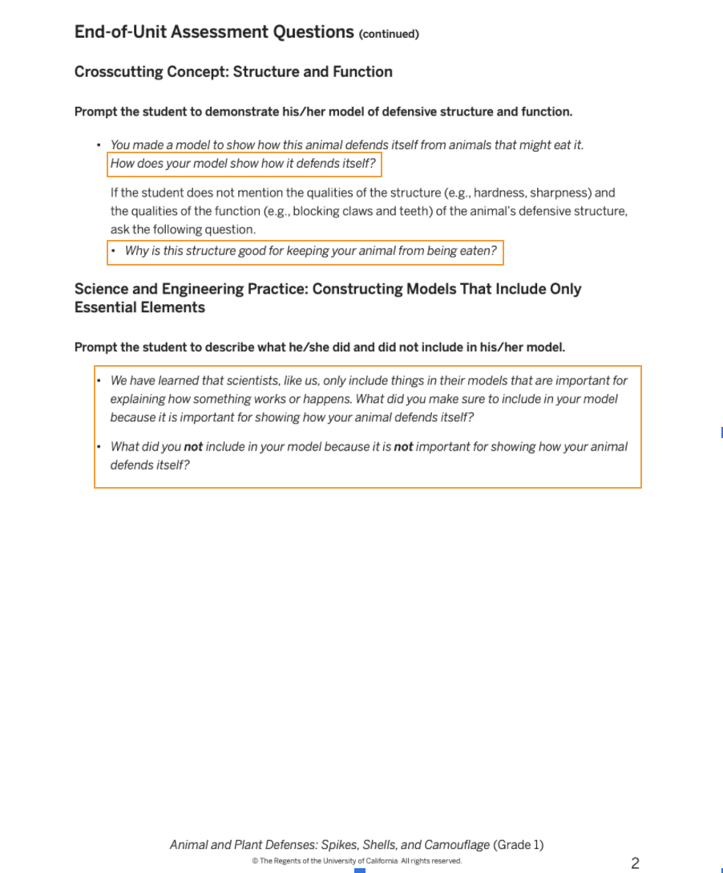
Type your responses here...
1.
2.
3.
4.

Slide 4
