Slide 1
Please make a copy before you begin working.
(File → Make a copy → Save to your drive)

Slide 2
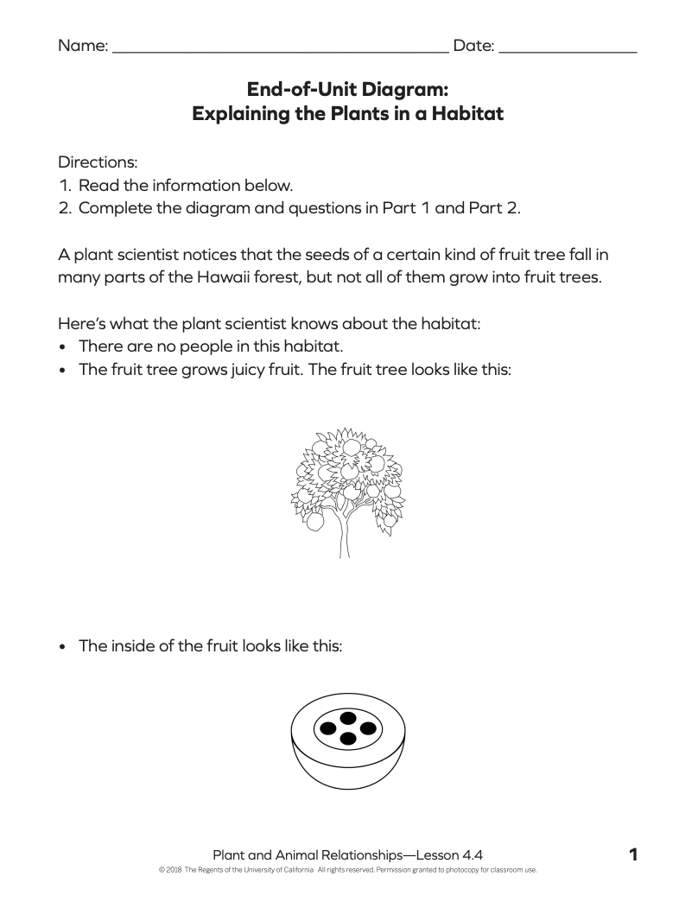

Slide 3
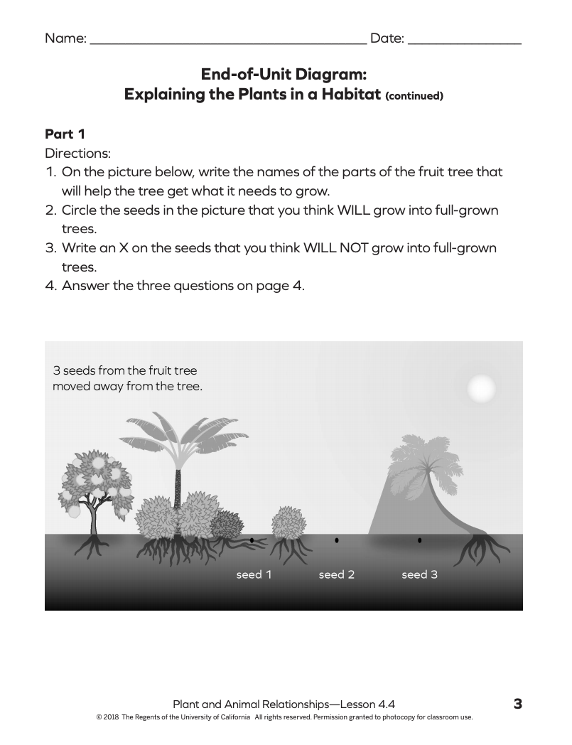
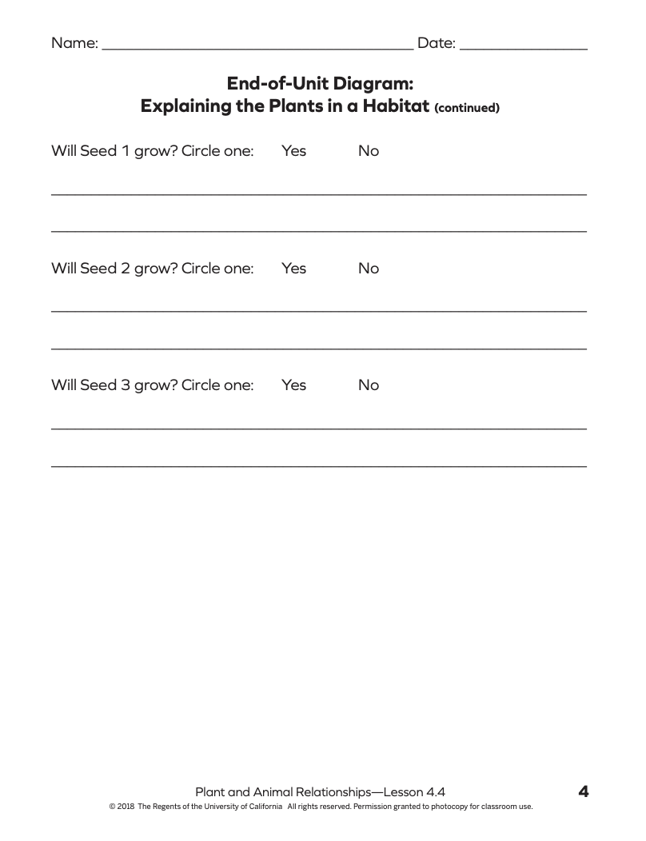
Type your response here...
Type your response here...
Type your response here...

Slide 4
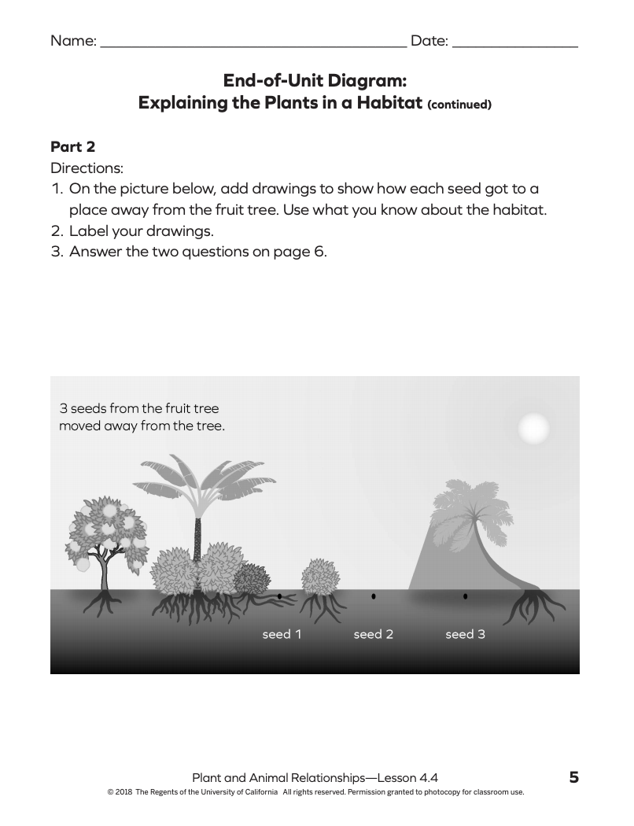
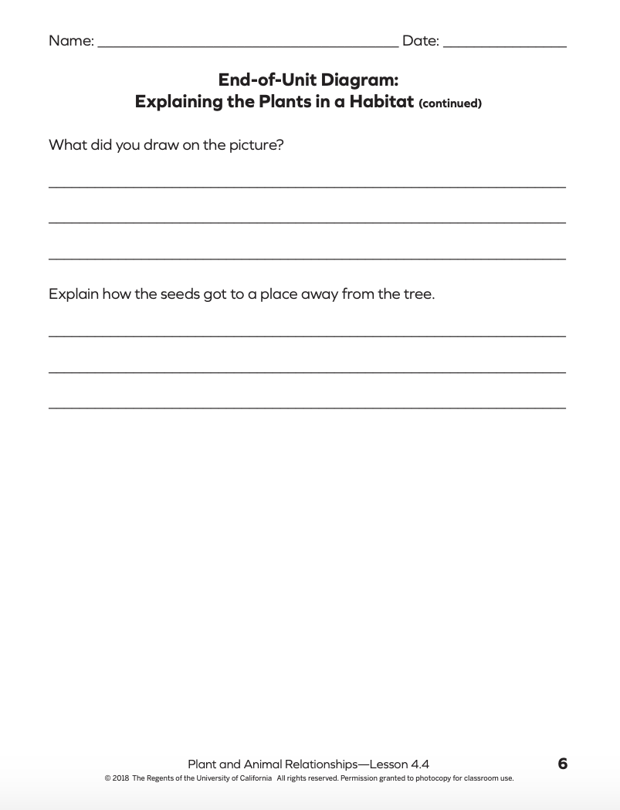
Type your response here...
Type your response here...

