Slide 1
Please make a copy before you begin working.
(File → Make a copy → Save to your drive)

Slide 2
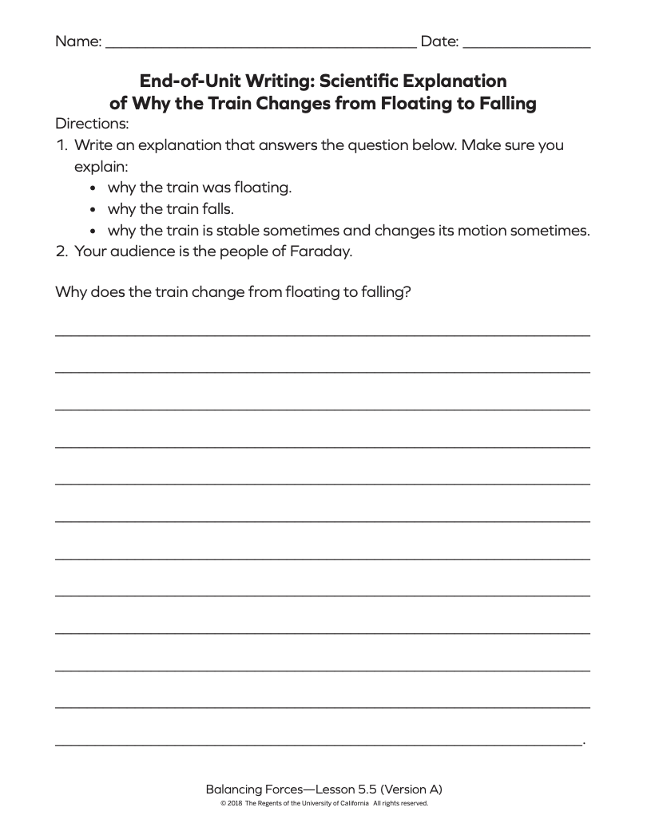
Type your response here...

