Slide 1
Please make a copy before you begin working.
(File → Make a copy → Save to your drive)

Slide 2
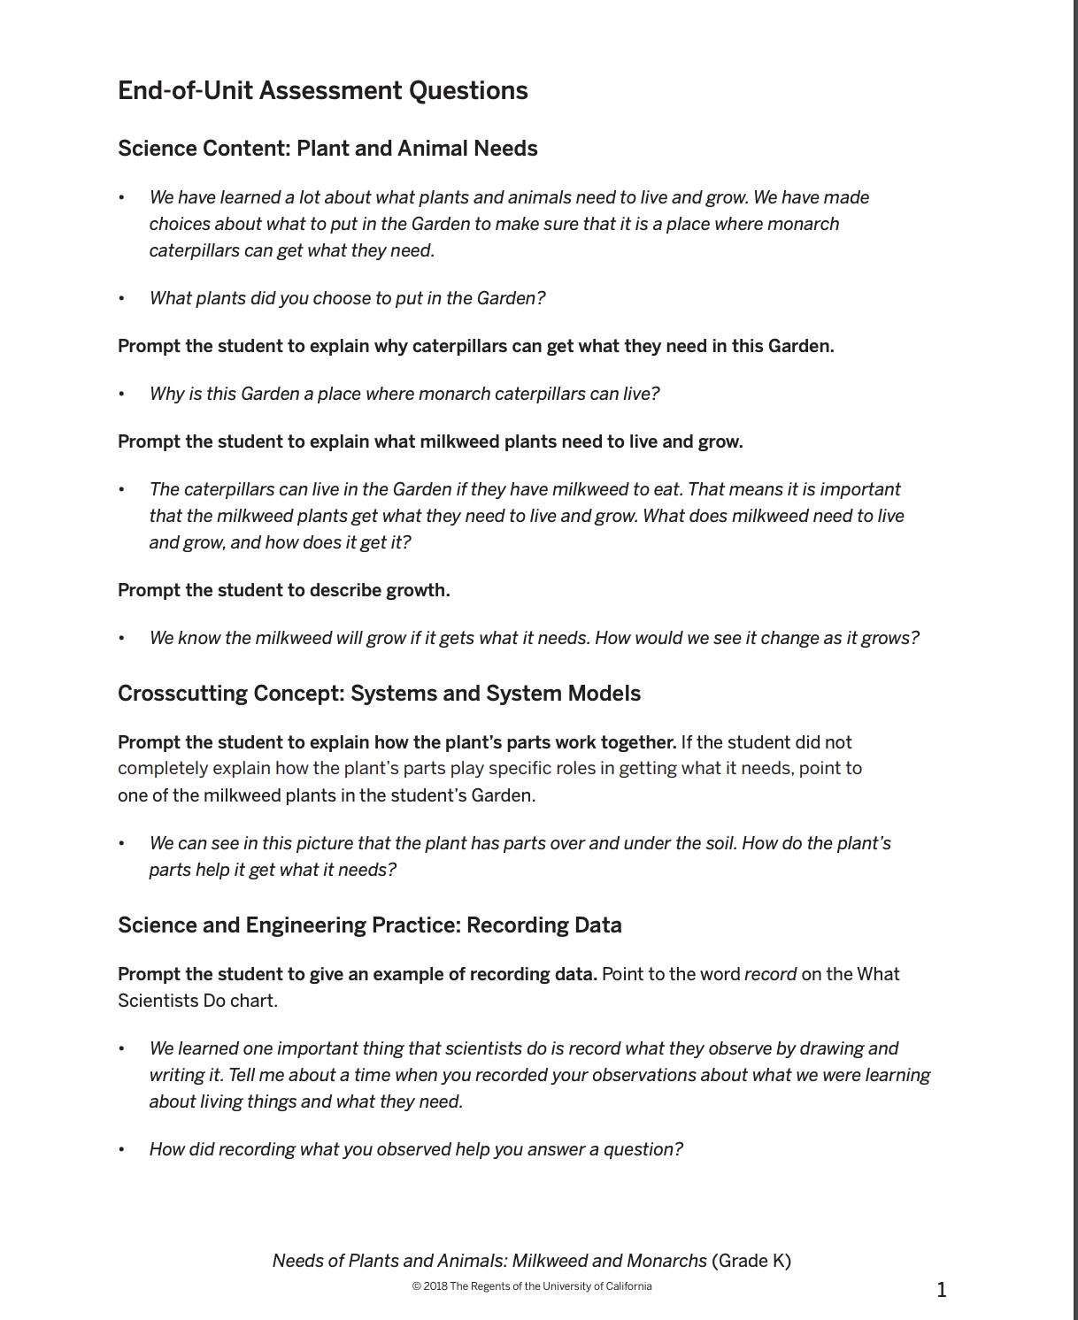
Type your responses here...
1.I put in radishes, lettuce, carrots, and milkweed.
2.Because I planted milkweed as well.
3.Milkweed needs sun and soil and water.
4.It will start as a little stem, then starts to grow leaves and as it gets bigger we might see flowering plant.
5.The roots provide water and minerals from the soil. The leaves get the energy from the sun.
6.The garden helped me think where I should put everything. Because people need some of the food as well. So I made sure there was enough for everybody.
Notes:
https://docs.google.com/presentation/d/1zGh8F-Vd7e4_58Of21J-ttXawpoiBN3y_j30CZwiD6o/edit#slide=id.g851ec1be9a_0_0

Slide 3
