Slide 1
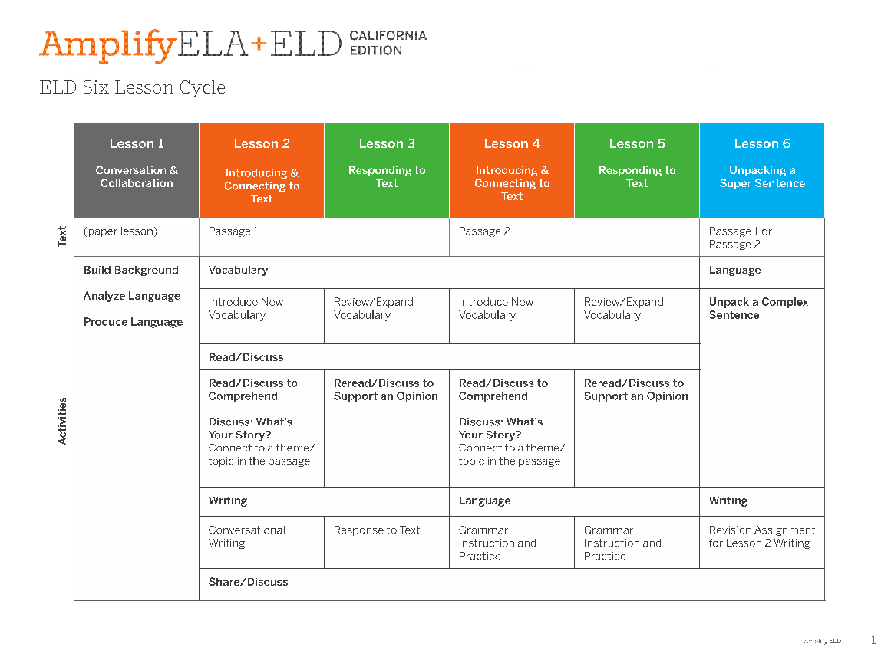
DISTANCE LEARNING - each lesson taught over 2 days
Deconstruct and analyze components of a complex sentence

Slide 2
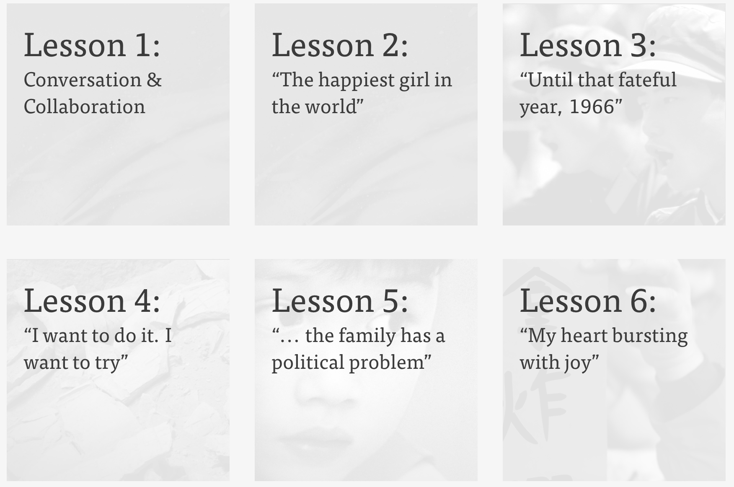
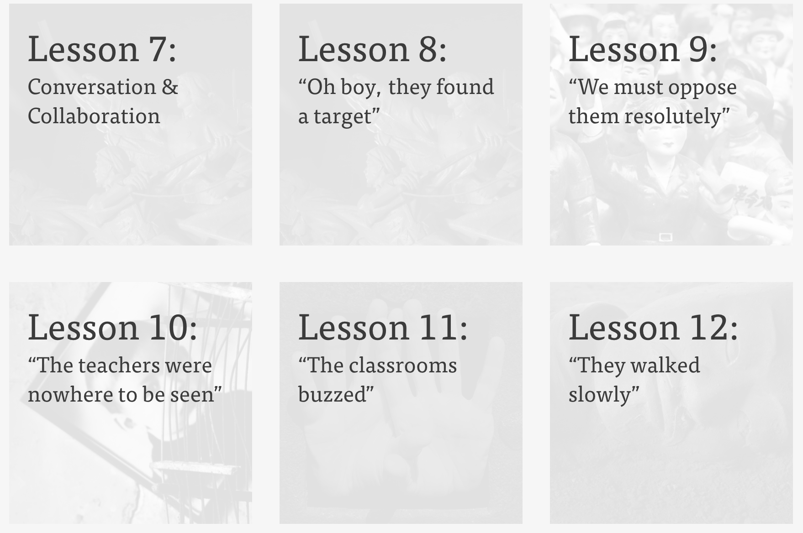
In-Person:
6-Lesson Cycle in a Sub-Unit
Distance Learning:
5-Lesson Cycle in a Sub-Unit
(one cycle will span 10 days)

Slide 3
DISTANCE LEARNING
Lesson Cycle
Lesson 1: Conversation & Collaboration
OMIT THIS LESSON
Lesson is teacher-facing only—PDF
Off-tablet experience where students put screens away and practice oral language skills via debate, oral presentation, interview, and collaborative writing.
Focus Areas:
Build background on texts: Students explore, examine, and discuss context related to the core text and their personal lives.
Analyze language: Students work independently or in pairs/groups to figure out the meaning of challenging words, phrases, and concepts from the core text.
Produce language: Students work in pairs/groups to improve conversation and oral presentation skills, and learn how to be an active listener and presenter.

Slide 4
Remote Resources - Conversation & Collaboration

Slide 5
Lesson Cycle
Lesson 2: Connect to Text
DISTANCE LEARNING
Day 1
Text Passage 1 and Vocabulary 1 (choose 2 words)
Comprehension questions on passage: Who, What, Where, etc.
Day 2
Write for Conversation prompt: narrative writing about a theme from the text
Share: give feedback

Slide 6
Lesson Cycle
Lesson 3: Respond to Text
DISTANCE LEARNING
Day 3
Text Passage 1 and Vocabulary 1 (choose same 2 words)
Discussion of passage: support your opinion about the text passage using textual evidence
Day 4
Write: support your ideas in writing about the text passage
Share: give feedback

Slide 7
DISTANCE LEARNING
Lesson Cycle
Lesson 4: Respond to Text & Language (similar to Lesson 2)
Day 5
Text Passage 2 and Vocabulary 2 (choose 2 words)
Comprehension questions on passage: Who, What, Where, etc.
Day 6
Language: practice grammar skill and then apply grammar skill in writing
Share: give feedback

Slide 8
DISTANCE LEARNING
Lesson Cycle
Lesson 5: Respond to Text & Language (similar to Lesson 3)
Day 7
Text Passage 2 and Vocabulary 2 (choose same 2 words)
Discussion of passage: support your opinion about the text passage using textual evidence
Day 8
Language: practice grammar skill and then apply grammar skill in writing
Share: give feedback

Slide 9
Lesson Cycle
Lesson 6: Unpack a Super Sentence
DISTANCE LEARNING
Day 9
Text Passage 1 or 2
Unpack a complex sentence: identify subject and predicate to make meaning of the sentence
Day 10
Revision: revise a sentence and add more detail to describe the subject
Share: give feedback

